Slide 1


Analyzing Student Data Survey
Project # 2 of marketing analytics NANODEGREE

Slide 2
This Presentation Main Contains Datavizzes & Their Corresponding Explanations
Data-Viz1 | DATAVIZ2 | DATAVIZ3 | DATAVIZ4
Distribution among Nanodegrees | Amount of time spent learning and practice times | Study Patterns among Master’s., Bachelor’s and ND holders | Over-all Age Distributions
Pie Chart | Bar Chart | Candle stick chart | Histograms
Top 10 were being presented | Includes all education levels & qualifications | Focuses specifically on the 3 specific education levels | Shows Udacity’s Age via Mean, Median and Mode

Slide 3
Which Nanodegrees were the most enrolled among surveyed students

Slide 4
Explanation for Data Viz # 1: TOP Nanodegrees
Udacity my dear education provider, has conducted a survey among students. Based on the initial findings in the data set, below are the top 10 Nanodegree programs offered by Udacity
1. Deep Learning (DL ND)
2. Machine Learning (ML ND)
3. Data Analyst (DA ND)
4. Artificial Intelligence (AI ND)
5. Null or None
6. Other Programs
7. Intro to Programming
8. Business Analyst ( now this is called Business Analysis ND or BAND)
9. Self Driving Cars ( SDC ND)
10. Robotics (now called Robotics Software Engineer ND)

Slide 5
Amount of time students spent on learning & honing their skills

Slide 6
Explanation for Data Viz # 2: Learning Time Management
The dataviz # 2 is a form of a clustered bar. The visualization yields a specific pattern. This mined result has given us 6 specific academic levels within learning and practice or study habits.
Bachelor’s and Master’s degree holders have topped the entire survey. Bachelor’s yielded 2,039 hours while Master’s holders have yielded 2003 hours. Doctorates have 453 hrs, NDs have 379 hrs, High School Grads have 138 hrs while those with associate degrees or diplomas have clocked 67 hours.
There appears to be an almost exact ‘mirroring’ of the trends between learning time and practice times.

Slide 7
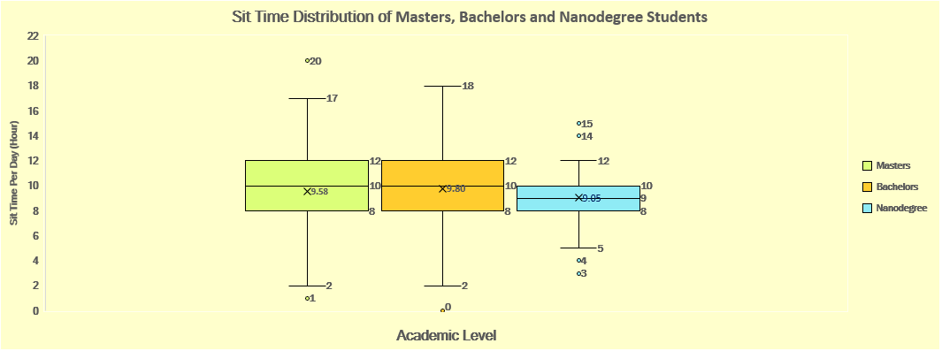
Differences in Patterns among surveyed students that have the following educations: ND, Master’s and BA

Slide 8
Explanations for Dataviz #3: Patterns among students
In the above box plots, I have considered the education levels: Master’s holders, Bachelors and Nanodegree holders.
I have noticed there was symmetry among the 3 education levels. The over-all interquartile range have yilded (4,4,2) , the standard deviations have resulted in ( 2.93,3.08, 2.58). Their ranges are (15,16,7). -> this also includes the outliers. These results could suggest that they do have very similar study patterns.
Also interesting to note, their means are ( Master’s have 9.58 , Bachelor’s have 9.80 and Nanodegrees have 9.0)

Slide 9
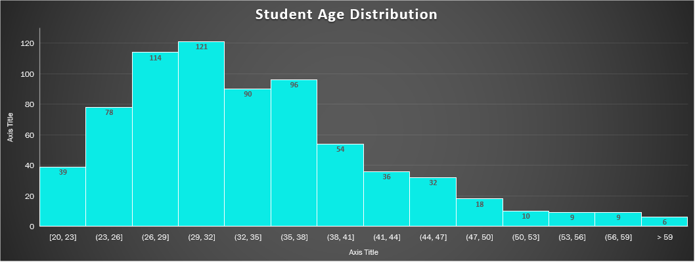
The over-all Age Distribution among students
Mean | =AVERAGE(A2:A754) | 34
Mode | =MODE.SNGL(A2:A754) | 30
Median | =MEDIAN(A2:A754) | 33

Slide 10
Explanation for Dataviz # 4: Age Distributions
The above dataviz shows a specifically right skewing distribution.
It yields the specific data:
The Mean is 34 years of age
The Mode is 30 years of age
The Median is 33 years of age
The Mode (30) appears to be the most frequently seen age within the age group of 26 to 32, From this, we could infer that the AVG age of students were in the early 30s.

